Slide 1

Automata
SCE 3rd

Slide 2
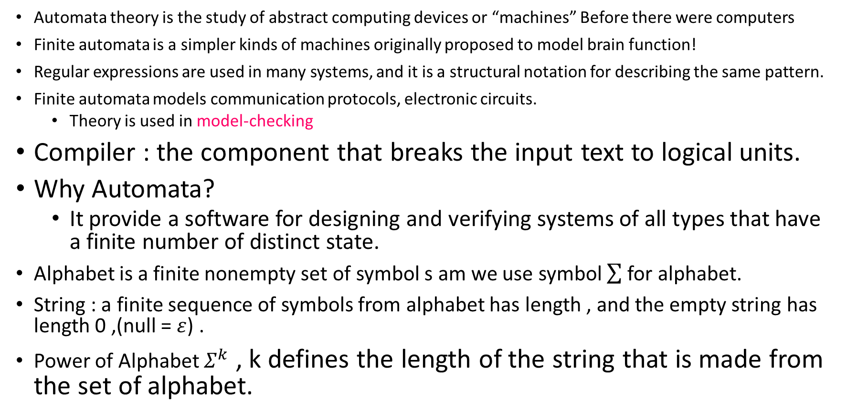
Intro.
Automata theory is the study of abstract computing devices or “machines” Before there were computers
Finite automata is a simpler kinds of machines originally proposed to model brain function!
Regular expressions are used in many systems, and it is a structural notation for describing the same pattern.
Finite automata models communication protocols, electronic circuits.
Theory is used in model-checking
Compiler : the component that breaks the input text to logical units.
Why Automata?
It provide a software for designing and verifying systems of all types that have a finite number of distinct state.
Alphabet is a finite nonempty set of symbol s am we use symbol for alphabet.
String : a finite sequence of symbols from alphabet has length , and the empty string has length 0 ,(null = $ε$) .
Power of Alphabet $Σ^{k}$ , k defines the length of the string that is made from the set of alphabet.

Slide 3
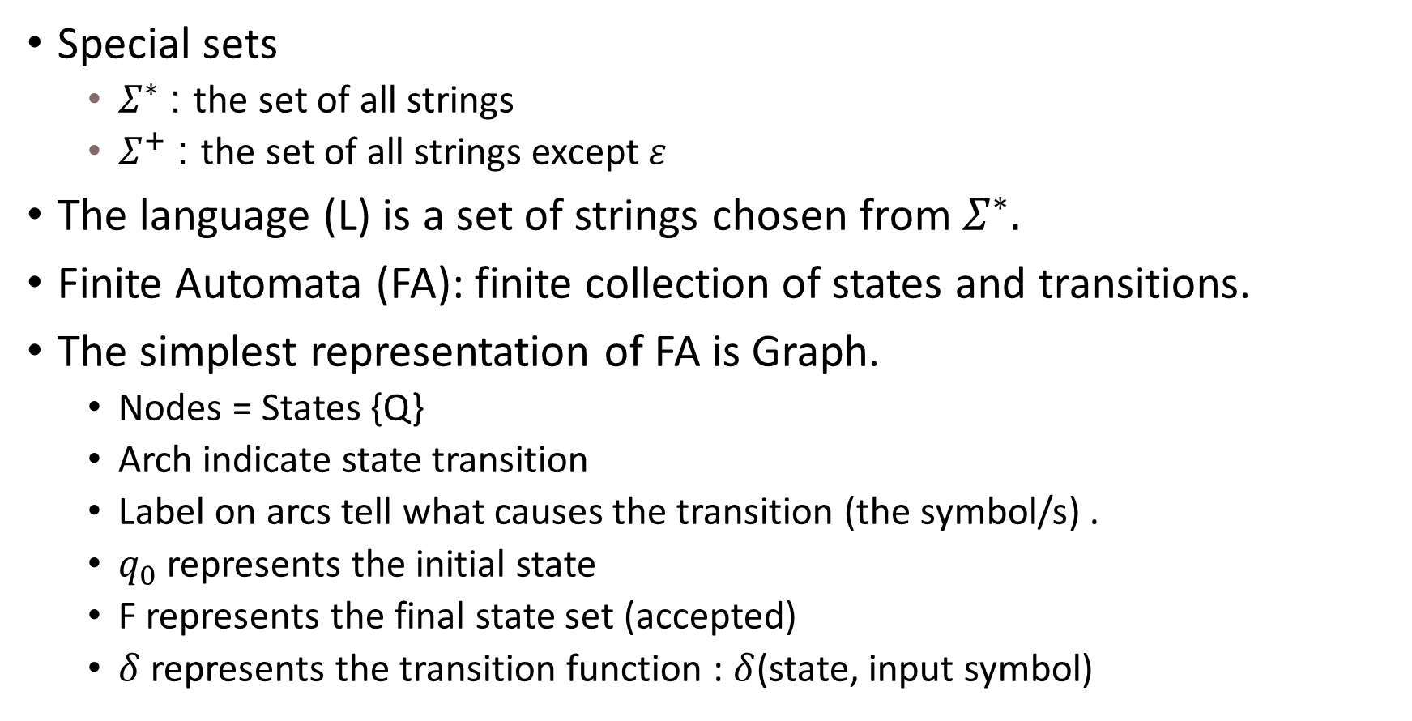
Cont.
Special sets
$Σ^{∗}$ : the set of all strings
$Σ^{+}$ : the set of all strings except $ε$
The language (L) is a set of strings chosen from $Σ^{∗}.$
Finite Automata (FA): finite collection of states and transitions.
The simplest representation of FA is Graph.
Nodes = States {Q}
Arch indicate state transition
Label on arcs tell what causes the transition (the symbol/s) .
$q_{0}$ represents the initial state
F represents the final state set (accepted)
$δ$ represents the transition function : $δ$(state, input symbol)
Notes:
The formal Notation for a FA :
A = (Q, $Σ$, $δ$, $q_{0}$ ,F)
WHERE :
A is the FA

Slide 4
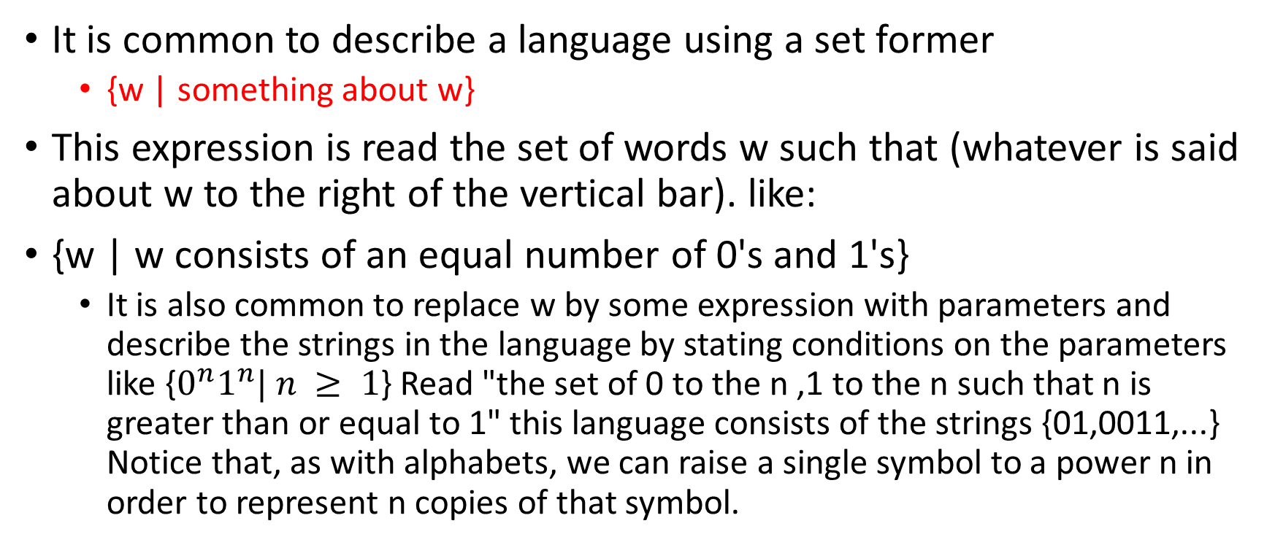
Set Former
It is common to describe a language using a set former
{w | something about w}
This expression is read the set of words w such that (whatever is said about w to the right of the vertical bar). like:
{w | w consists of an equal number of 0's and 1's}
It is also common to replace w by some expression with parameters and describe the strings in the language by stating conditions on the parameters like {$0^{n}1^{n}| n ≥ 1$} Read "the set of 0 to the n ,1 to the n such that n is greater than or equal to 1" this language consists of the strings {01,0011,...} Notice that, as with alphabets, we can raise a single symbol to a power n in order to represent n copies of that symbol.

Slide 5
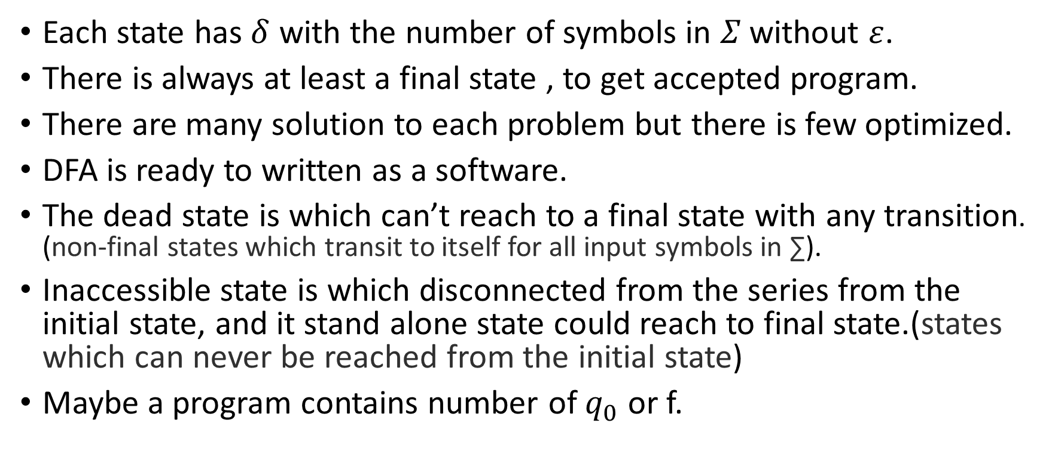
Deterministic Finite Automata (DFA)
Each state has $δ$ with the number of symbols in $Σ^{ }$without $ε$.
There is always at least a final state , to get accepted program.
There are many solution to each problem but there is few optimized.
DFA is ready to written as a software.
The dead state is which can’t reach to a final state with any transition. (non-final states which transit to itself for all input symbols in ∑).
Inaccessible state is which disconnected from the series from the initial state, and it stand alone state could reach to final state.(states which can never be reached from the initial state)
Maybe a program contains number of $q_{0}$ or f.

Slide 6
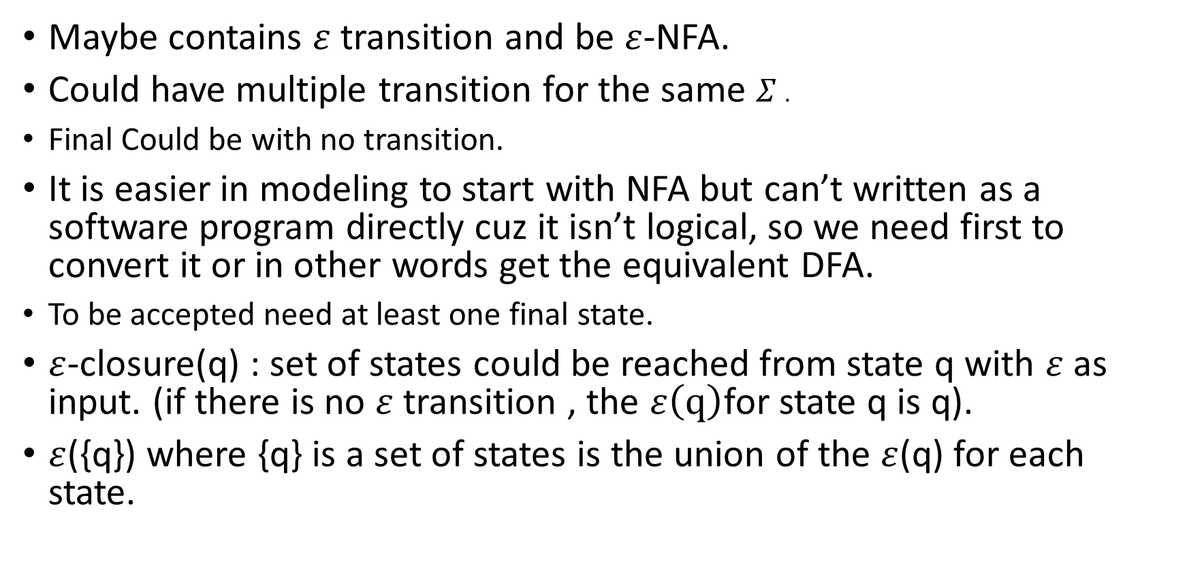
Non-Deterministic Finite Automata (NFA)
Maybe contains $ε$ transition and be $ε$-NFA.
Could have multiple transition for the same $Σ^{ }$.
Final Could be with no transition.
It is easier in modeling to start with NFA but can’t written as a software program directly cuz it isn’t logical, so we need first to convert it or in other words get the equivalent DFA.
To be accepted need at least one final state.
$ε$-closure(q) : set of states could be reached from state q with $ε$ as input. (if there is no $ε$ transition , the $ε\left(q\right)$for state q is q).
$ε$({q}) where {q} is a set of states is the union of the $ε$(q) for each state.

Slide 7
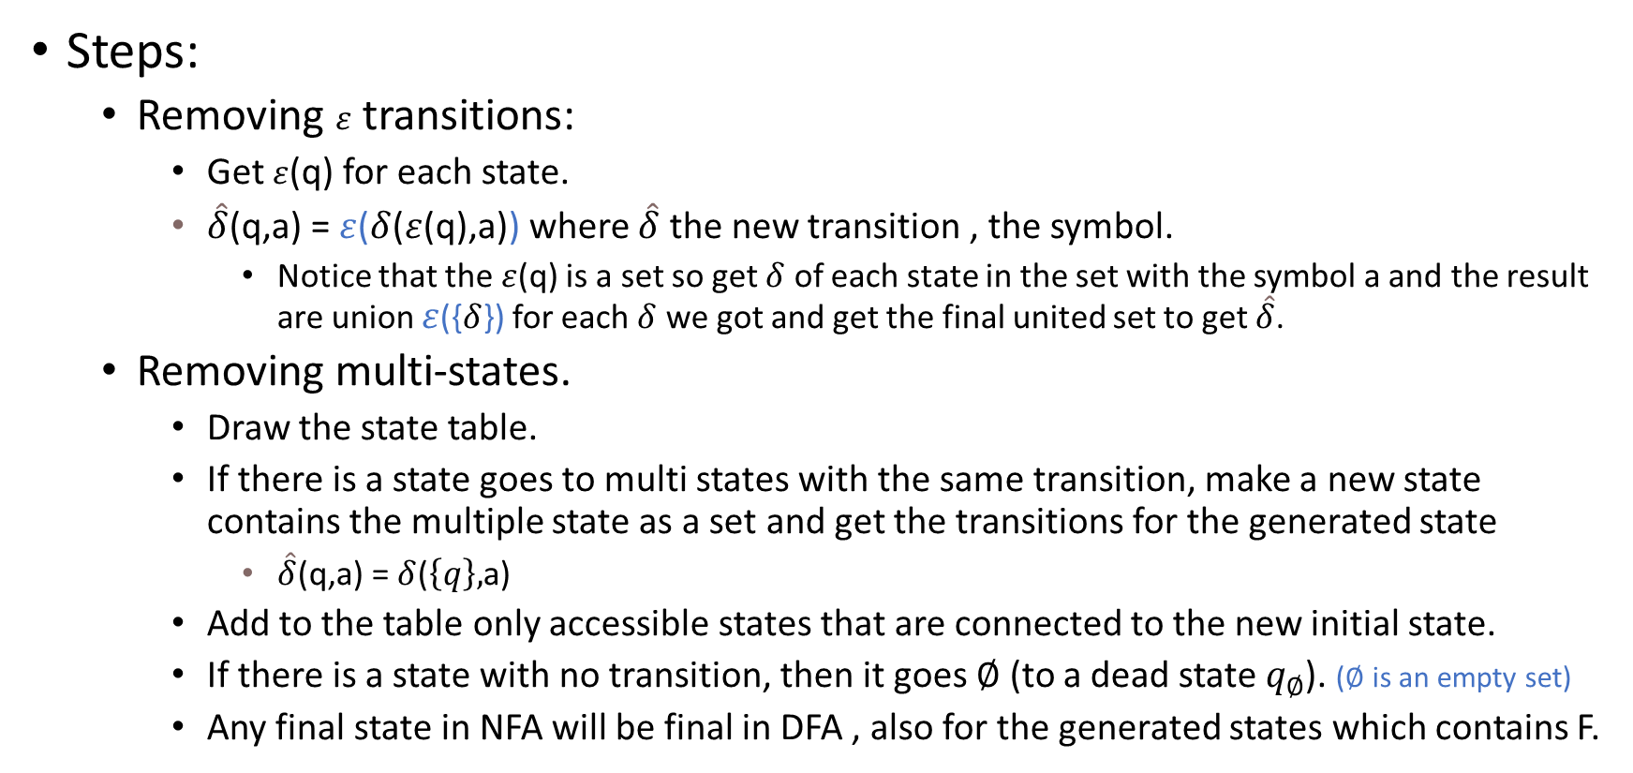
Get the equivalence of DFA , NFA
Steps:
Removing $ε$ transitions:
Get $ε$(q) for each state.
$\hat{δ}$(q,a) = $ε$($δ$($ε$(q),a)) where $\hat{δ}$ the new transition , the symbol.
Notice that the $ε$(q) is a set so get $δ$ of each state in the set with the symbol a and the result are union $ε$({$δ$}) for each $δ$ we got and get the final united set to get $\hat{δ}$.
Removing multi-states.
Draw the state table.
If there is a state goes to multi states with the same transition, make a new state contains the multiple state as a set and get the transitions for the generated state
$\hat{δ}$(q,a) = $δ$($\left\{q\right\},$a)
Add to the table only accessible states that are connected to the new initial state.
If there is a state with no transition, then it goes $∅$ (to a dead state $q_{∅}$). ($∅$ is an empty set)
Any final state in NFA will be final in DFA , also for the generated states which contains F.

Slide 8
Minimization of DFA
The process of reducing a given DFA to its minimal form (minimum number of states).
Minimize DFA
Equivalence Theorem
Eliminate all the dead states and inaccessible states from the given DFA (if any).
Draw a state transition table for the given DFA.(Transition table shows the transition of all states on all input symbols in Σ.)
Take a counter variable k and initialize it with value 0 AND FIND P0
P0 = Divide Q (set of states) into two sets such that one set contains all the non-final states and other set contains all the final states.
K++ , find the pk by comparing P_{k-1} multistate set states and if there is a state has a transition to a state in other set then eliminate those states from each stage to a new set, notice that if there are many states eliminated in the same stage will be in the same set.
Keep repeating till P_{k} = P_{k-1.}
Each set represent a new state with the same transitions.

Slide 9
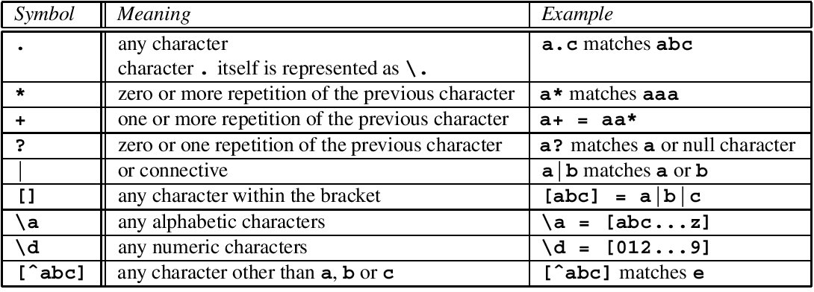

Regular Expression (RE)
Any symbol or string or even $ε$, $∅$ as a RE.
Let E1,E2 a RE THEN
E1+E2 IS RE , L(E1+E2) = L(E1)UL(E2)
E1.E2 IS RE , L(E1E2) = L(E1)L(E2)
E* IS RE , L(E*) = (L(E))*
Identities and annihilators:
R+ $∅$ = R
$∅$ . R = $∅$
$ε$ . R = R

Slide 10
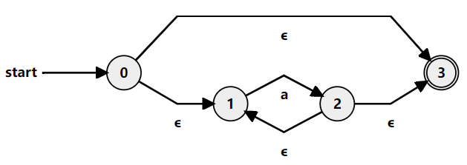


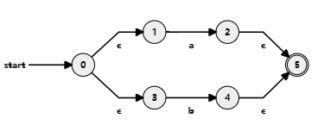

CONT.
IF a , b symbols and RE then:
a*
a.b
a+b (a|b)

Slide 11
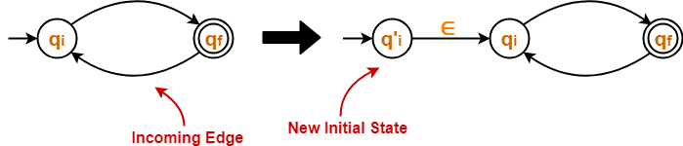
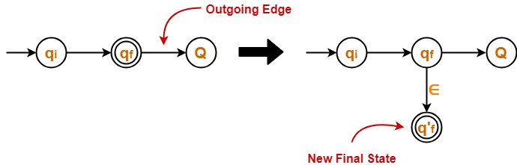
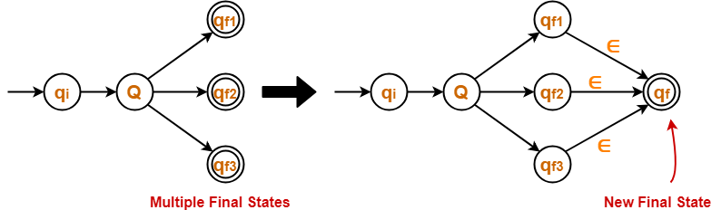
Conversion from FA to RE
There is two ways to get the RE from a FA:
State Elimination Method for any FA:
If there exists any incoming edge to the initial state, then create a new initial state having no incoming edge to it.
If there exists multiple final states in the DFA, then convert all the final states into non-final states and create a new single final state.
The final state of the DFA must not have any outgoing edge.
Eliminate all the intermediate states one by one in any order except initial and final state.

Slide 12
Conversion from FA to RE
Arden’s Method for NFA or DFA:
USE CONITION:
The transition diagram must not have any ∈ transitions. (for ∈-NFA eliminate ∈ first).
There must be only a single initial state.
STEPS:
Form an equation for each state considering the transitions which comes towards that state. (Add ‘∈’ in the equation of initial state).
SUBSTITUTE
Bring final state in the form R = Q + RP to get the required regular expression.
R = Q + RP has a unique solution i.e., R = QP* where(a,p ARE RE).
If there exists multiple final states, then Write a regular expression for each final state separately and Add all the regular expressions to get the final regular expression.

